Slide 2
Outputs from First Visit - JSA Team
JSA Baseline Data and JSA Plan - July to September 2018
District Water Conservation Plan
Information, Education and Communication (IEC Plan) and Media Plan
Details of Central, State and GP Fund
Atleast 1 site (photo) for each of the 5 interventions area to be chosen (Before & After photos also to be ensured)
Day to Day activity of Visiting Team

Slide 3
1. JSA Baseline Data and JSA Plan
Water Table levels
Inventory of Tanks
Ponds created under MGNREGA
Traditional Water Bodies
Government Building with functional Rain Water Harvesting
Borewells requiring Point Recharge
Watershed Activities
Afforestation

Slide 4
1. Water Table levels
Need to take details of existing water table level at district, block and GP wise
Sl No | District/Block/GP | Public/Private | Geo Coordinates | Water Level (m) before intervention

Slide 5
2. Inventory of Other Water Bodies/Tanks
Need to take details of tanks having more than 5 Hectare area of surface area
Sl No | District/Block/GP | Coordinates | Capacity (Cubic metre) before intervention

Slide 6
3. Ponds created under MGNREGA
Need to take details of ponds created under MGNREGA during July to September 2018
Sl No | District/Block/GP | Latitude/Longitude | Capacity of the pond (Cu. m)

Slide 7
4. Traditional Water Bodies
Need to take details of traditional water bodies in consultation with local citizens
The water bodies which have existed since very long time ( approximately more than 10 years) and which have served community for drinking water and other purposes
Sl No | District/Block/GP | Coordinates | Type of Water Body (Tank, Ponds, Lakes etc) | Capacity (Cubic Metres)

Slide 8
5. Government Building with functional Rain Water Harvesting
Need to take details of buildings where there is active and working rain water harvesting structures in government buildings
Sl No | District/Block/GP | Geo Coordin ates | Type of Government Building having RWH Structures ( Offices, Schools, Hospitals etc) | Functional (Yes/No)

Slide 9
6 . Bore wells requiring Point Recharge
Need to take details of all the bore wells used for drinking water which get dried during summer each year and which require point recharge
Sl No | District/Block/GP | Geo Coordinates | No of Borewells | Depth of Bore well (feet)

Slide 10
7 . Watershed Activities
Need to take details of all the watershed works like check dams, gully plugs and percolation tanks for a micro watershed of 500 hectares
Sl No | District/Block/GP | Geo Cordinates | Nature of Watershed Works (checkdam /Gully Plugs/ percolation tanks) | Number of works

Slide 11
8 . Intensive Afforestation
Need to take details of all the saplings planted during July to September 2018
Sl No | District/Block/GP | Number of Saplings Planted | Survival Percentage | Area planted in Hectare

Slide 12
JSA PLAN
Sl No | Interventions | 15th July Target | 15th July Expenditure | 30th July Target | 30th July Expenditure | 15th August Target | 15th August Expenditure | 30th August Target | 30th August Expenditure
1 | Water Conservation and Rainwater Harvesting
2 | Renovation of Traditional and Water Bodies/Tanks
3 | Watershed Development
4 | Reuse and Borewell Recharge Structures
5 | Intensive Afforestation
6 | Special Interventions

Slide 13
2. Outputs on District Water Conservation Plan

Slide 14
Outputs on District Water Conservation Plan
District Irrigation Plan- If yes Give details of the district irrigation plan.
2. Refer to District Irrigation plan and integrate it with district water conservation plan at district and Block level. Tentative Water Conservation Plan is given for reference. However Central Nodal Officers can modify accordingly as per the needs of the districts.

Slide 15
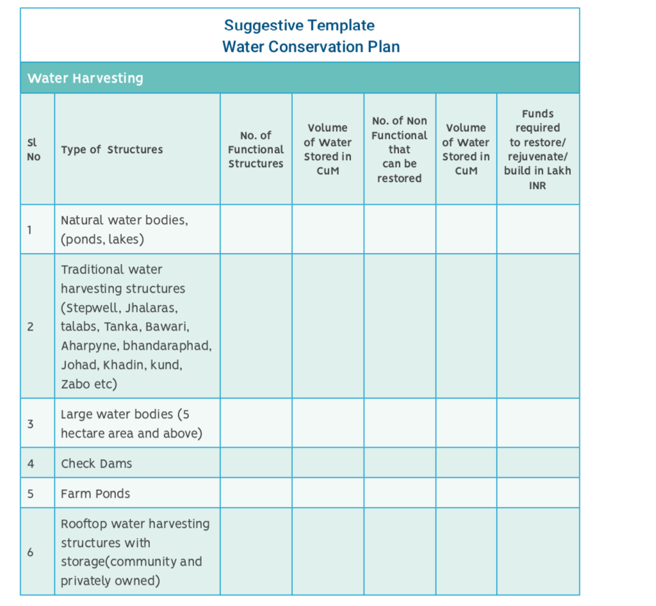

Slide 16
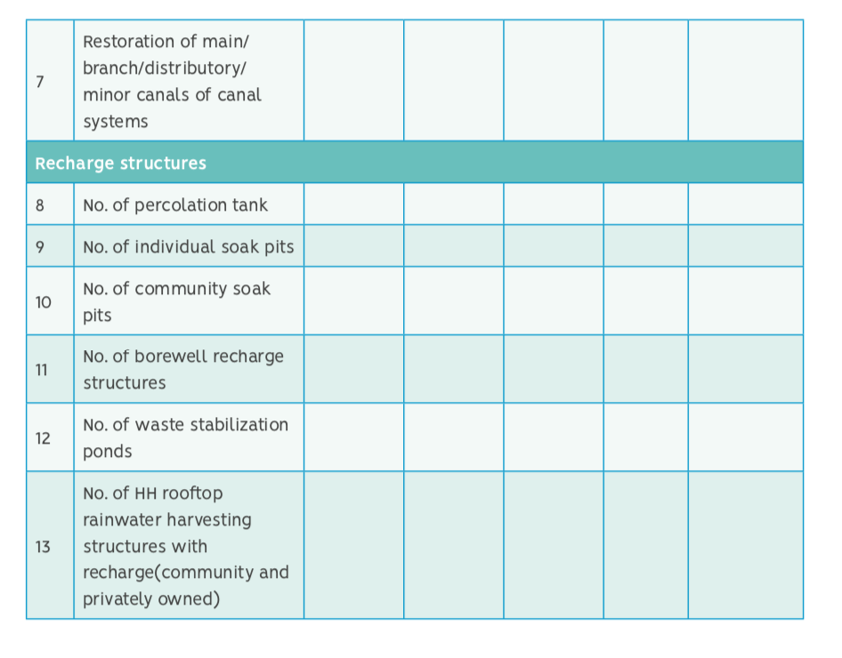

Slide 17
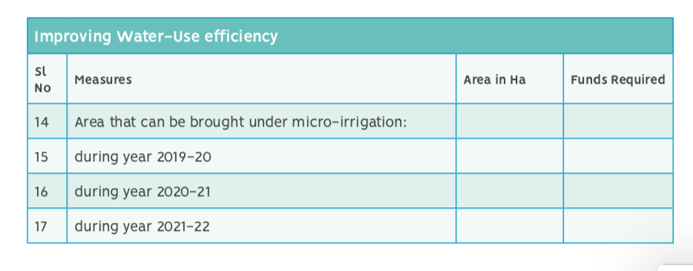

Slide 18
3. Information, Education and Communication (IEC Plan) & Media Plan

Slide 19
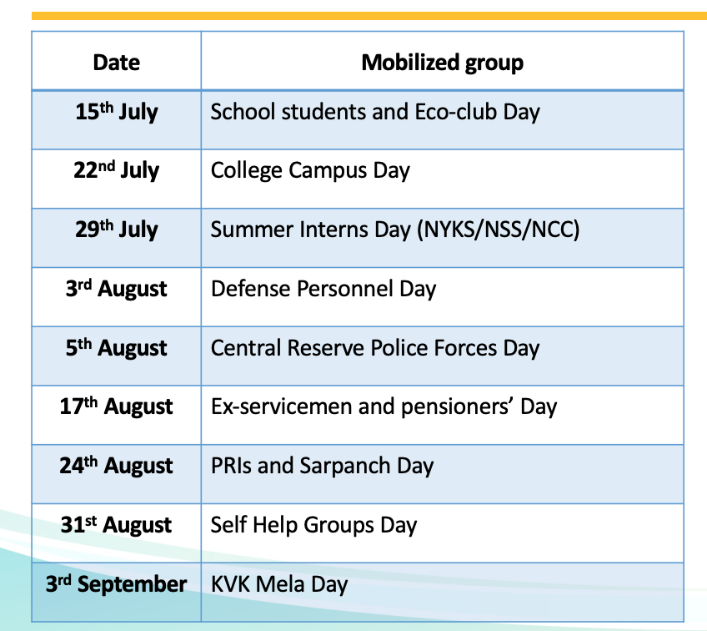

Slide 20
Print and Electronic Media Outreach Plan
Advertisements
Jingles
FM Radio and Akashavani
Beating of Tom Tom in villages
Awareness and Sensitization programmes in schools and colleges

Slide 21
Number of People to be Mobilized
Sl No | Target Groups | Number of Camps/ meetings organised | Number of people Mobilized
1 | Schools
2 | Colleges
3 | NYS/NSS/NCC
4 | SHGs
5 | PRIs and Sarpanchas
6 | Police and Defence Personnels

Slide 22
4. Details of Central, State and GP Funds
Sl No | District | Intervention Area | Central Funds | State Funds | GP Funds

Slide 23
Day to Day activity of the visiting team

Slide 24
Day to Day activity of the visiting team
Activities include meetings conducted, field visits done , Identification of funds, functions and functionaries required for the interventions.
PDF file has to be uploaded on a daily basis wrt activities done
Days | District | Block | Description
1
2
3

Slide 25
Instructions on how to use the portal

